Slide 1
Why do we need statistics?
Prof. Andy Field

Slide 2
Types of Data Analysis
Quantitative Methods
Testing theories using numbers
Qualitative Methods
Testing theories using language
Magazine articles/Interviews
Conversations
Newspapers
Media broadcasts

Slide 3
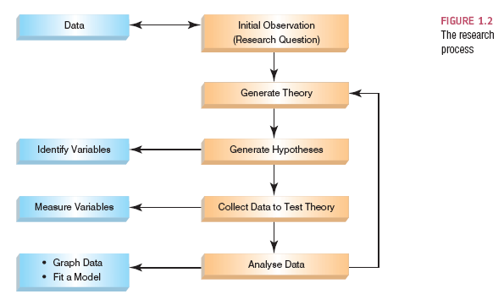
The Research Process

Slide 4
Initial Observation
Find something that needs explaining
Observe the real world
Read other research
Test the concept: collect data
Collect data to see whether your hunch is correct
To do this you need to define variables
Anything that can be measured and can differ across entities or time.

Slide 5
The Research Process

Slide 6
Generating and Testing Theories
Theories
An hypothesized general principle or set of principles that explain known findings about a topic and from which new hypotheses can be generated.
Hypothesis
A prediction from a theory.
E.g. the number of people turning up for a Big Brother audition that have narcissistic personality disorder will be higher than the general level (1%) in the population.
Falsification
The act of disproving a theory or hypothesis.

Slide 7
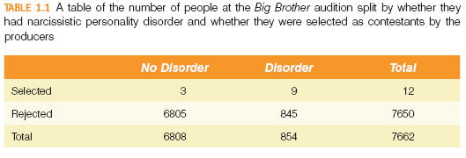

Slide 8
The Research Process

Slide 9
Collect Data to Test Your Theory
Hypothesis:
Coca-cola kills sperm.
Independent Variable
The proposed cause
A predictor variable
A manipulated variable (in experiments)
Coca-cola in the hypothesis above
Dependent Variable
The proposed effect
An outcome variable
Measured not manipulated (in experiments)
Sperm in the hypothesis above

Slide 10
Levels of Measurement
Categorical (entities are divided into distinct categories):
Binary variable: There are only two categories
e.g. dead or alive.
Nominal variable: There are more than two categories
e.g. whether someone is an omnivore, vegetarian, vegan, or fruitarian.
Ordinal variable: The same as a nominal variable but the categories have a logical order
e.g. whether people got a fail, a pass, a merit or a distinction in their exam.
Continuous (entities get a distinct score):
Interval variable: Equal intervals on the variable represent equal differences in the property being measured
e.g. the difference between 6 and 8 is equivalent to the difference between 13 and 15.
Ratio variable: The same as an interval variable, but the ratios of scores on the scale must also make sense
e.g. a score of 16 on an anxiety scale means that the person is, in reality, twice as anxious as someone scoring 8.

Slide 11
Measurement Error
Measurement error
The discrepancy between the actual value we’re trying to measure, and the number we use to represent that value.
Example:
You (in reality) weigh 80 kg.
You stand on your bathroom scales and they say 83 kg.
The measurement error is 3 kg.

Slide 12
Validity
Whether an instrument measures what it set out to measure.
Content validity
Evidence that the content of a test corresponds to the content of the construct it was designed to cover
Ecological validity
Evidence that the results of a study, experiment or test can be applied, and allow inferences, to real-world conditions.

Slide 13
Reliability
Reliability
The ability of the measure to produce the same results under the same conditions.
Test-Retest Reliability
The ability of a measure to produce consistent results when the same entities are tested at two different points in time.

Slide 14
How to Measure
Correlational research:
Observing what naturally goes on in the world without directly interfering with it.
Cross-sectional research:
This term implies that data come from people at different age points with different people representing each age point.
Experimental research:
One or more variable is systematically manipulated to see their effect (alone or in combination) on an outcome variable.
Statements can be made about cause and effect.

Slide 15
Experimental Research Methods
Cause and Effect (Hume, 1748)
Cause and effect must occur close together in time (contiguity);
The cause must occur before an effect does;
The effect should never occur without the presence of the cause.
Confounding variables: the ‘Tertium Quid’
A variable (that we may or may not have measured) other than the predictor variables that potentially affects an outcome variable.
E.g. The relationship between breast implants and suicide is confounded by self esteem.
Ruling out confounds (Mill, 1865)
An effect should be present when the cause is present and that when the cause is absent the effect should be absent also.
Control conditions: the cause is absent.

Slide 16
Methods of Data Collection
Between-group/Between-subject/independent
Different entities in experimental conditions
Repeated measures (within-subject)
The same entities take part in all experimental conditions.
Economical
Practice effects
Fatigue

Slide 17
Types of Variation
Systematic Variation
Differences in performance created by a specific experimental manipulation.
Unsystematic Variation
Differences in performance created by unknown factors.
Age, Gender, IQ, Time of day, Measurement error etc.
Randomization
Minimizes unsystematic variation.

Slide 18
The Research Process

Slide 19
Analysing Data: Histograms
Frequency Distributions (aka Histograms)
A graph plotting values of observations on the horizontal axis, with a bar showing how many times each value occurred in the data set.
The ‘Normal’ Distribution
Bell shaped
Symmetrical around the centre

Slide 20
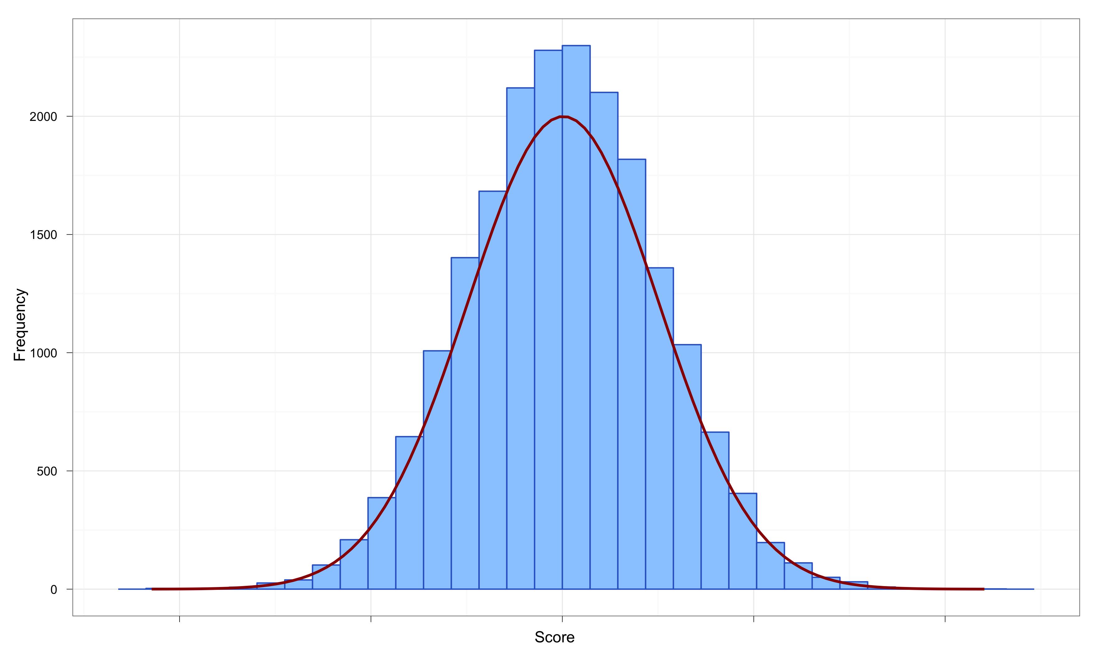
The Normal Distribution
The curve shows the idealized shape.

Slide 21
Properties of Frequency Distributions
Skew
The symmetry of the distribution.
Positive skew (scores bunched at low values with the tail pointing to high values).
Negative skew (scores bunched at high values with the tail pointing to low values).
Kurtosis
The ‘heaviness’ of the tails.
Leptokurtic = heavy tails.
Platykurtic = light tails.

Slide 22
Skew

Slide 23
Kurtosis

Slide 24
Central tendency: The Mode
Mode
The most frequent score
Bimodal
Having two modes
Multimodal
Having several modes

Slide 25
Bimodal and Multimodal Distributions

Slide 26
Central Tendency: The Median
The Median is the middle score when scores are ordered:

Slide 27
Central Tendency: The Mean
Mean
The sum of scores divided by the number of scores.
Number of friends of 11 Facebook users.

Slide 28
The Dispersion: Range
The Range
The smallest score subtracted from the largest
For our Facebook friends data the highest score is 234 and the lowest is 22; therefore the range is: 234 −22 = 212

Slide 29
The Dispersion: The Interquartile range
Quartiles
The three values that split the sorted data into four equal parts.
Second Quartile = median.
Lower quartile = median of lower half of the data
Upper quartile = median of upper half of the data

Slide 30
Deviance
We can calculate the spread of scores by looking at how different each score is from the center of a distribution e.g. the mean:

Slide 31
Sum of Squared Errors, SS
Indicates the total dispersion, or total deviance of scores from the mean:
It’s size is dependent on the number of scores in the data.
More useful to work with the average dispersion, known as the variance:

Slide 32
Standard Deviation
The variance gives us a measure in units squared.
In our Facebook example we would have to say that the average error in out data was 3224.6 friends squared.
This problem is solved by taking the square root of the variance, which is known as the standard deviation:

Slide 33
Same Mean, Different SD

Slide 34
Using a Frequency Distribution to go Beyond the Data

Slide 35
Important Things to Remember
The Sum of Squares, Variance, and Standard Deviation represent the same thing:
The ‘Fit’ of the mean to the data
The variability in the data
How well the mean represents the observed data
Error

Slide 36
The Normal Probability Distribution

Slide 37
Going beyond the data: Z-scores
Z-scores
Standardising a score with respect to the other scores in the group.
Expresses a score in terms of how many standard deviations it is away from the mean.
The distribution of z-scores has a mean of 0 and SD = 1.

Slide 38
Properties of z-scores
1.96 cuts off the top 2.5% of the distribution.
−1.96 cuts off the bottom 2.5% of the distribution.
As such, 95% of z-scores lie between −1.96 and 1.96.
99% of z-scores lie between −2.58 and 2.58,
99.9% of them lie between −3.29 and 3.29.

Slide 39
Probability Density function of a Normal Distribution

Slide 40
Reporting Data
Dissemination of Research
Findings are presented at conferences and in articles published in scientific journals.
Knowing how to report data
Chose a mode of presentation that optimizes the understanding of the data;
If you present three or fewer numbers then try using a sentence;
If you need to present between 4 and 20 numbers consider a table;
If you need to present more than 20 numbers then a graph is often more useful than a table.

